Slide 1

SA Presentation
By Naughty Cat LLC

Slide 2
Table of Contents
Introduction
Storyboard
Context Diagram
Diagram 0
Global Use Case
Questions

Slide 3
Introduction
Name of the Game: Zombie Dog Outbreak 2
Goal: Endless Zombie Shooter unless you find the elements to cure the dogs.
Introduce Ourselves:
Bryce - Character Manager
Carson - Instantiate Game
Tosin - Cutscene/storyline manager
Marissa - Sound and Item Manager
Molly - Enemy Manager
Ambrea - Inventory and UI Manager

Slide 4
Naughty Cat LLC Presents: Zombie Dog Outbreak 2
Project Objectives:
Unlimited levels with increasing difficulty
Playable main character with movement and access to inventory
Displays scores and items in inventory
Display screens for main menu, game paused, and the general game itself as well as cutscenes
Enemy AI sprites that the user plays against
An optional storyline for the player
Runs with no glitches that alter the gameplay

Slide 5
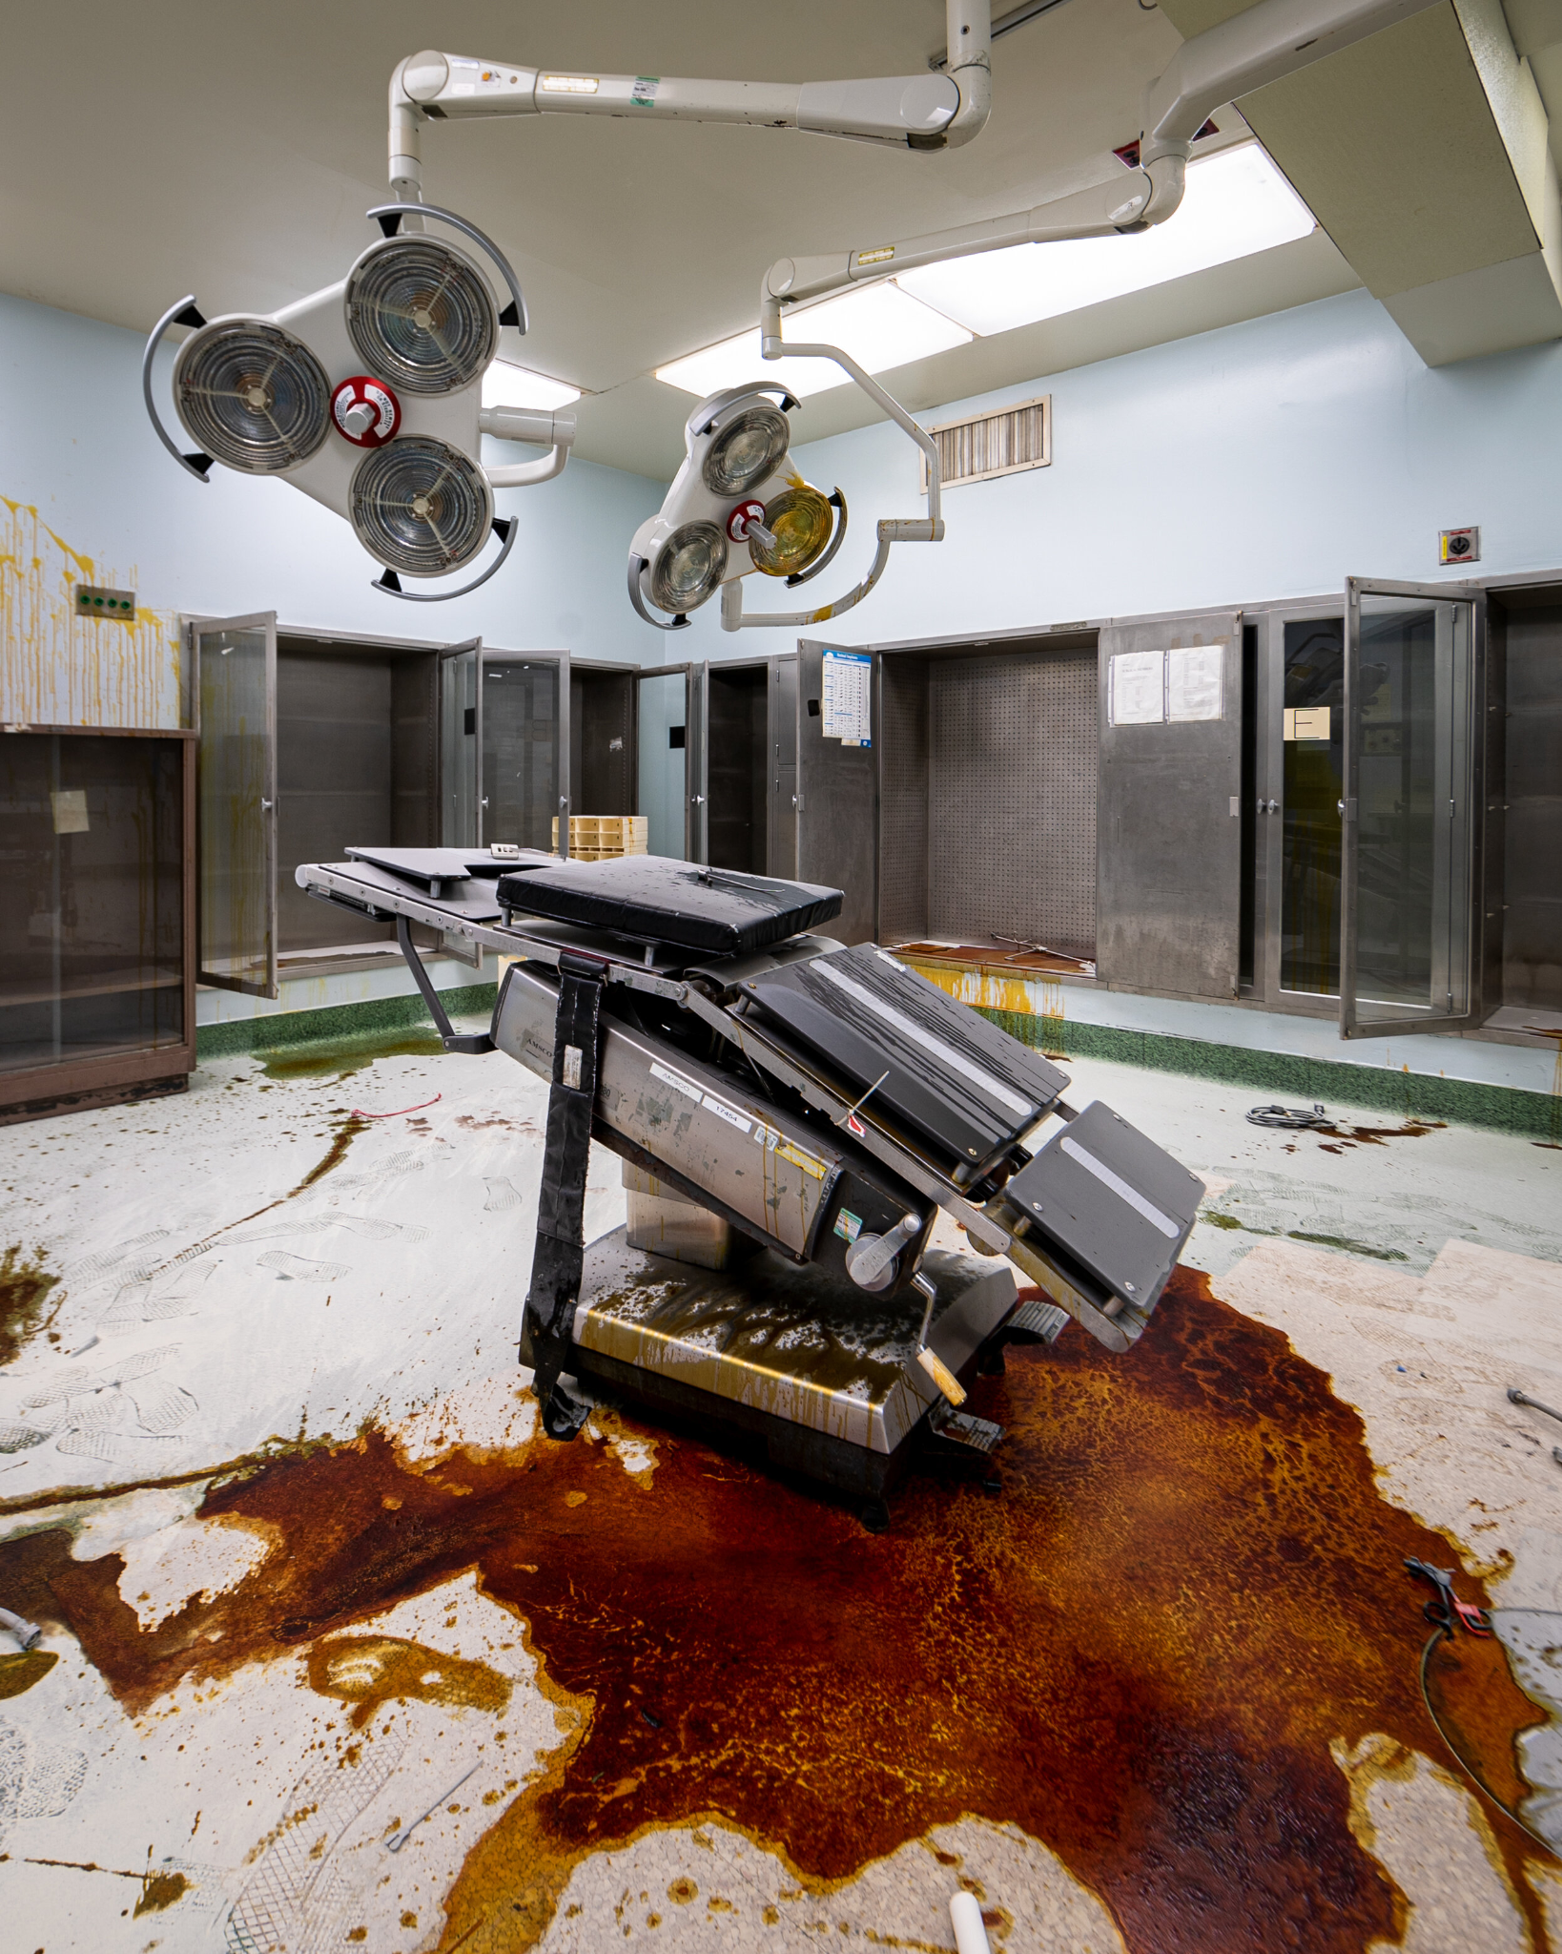

Start Game
The player will spawn as a nurse cat in a zombie infested vet clinic. The cat has been unconscious in an exam room and isn’t sure what happened, but it’s evident that the zombie dogs intend to kill them. The exam room is connected to an open hallway, all of the doors leading from which are locked.

Slide 6





Lore
The player will slowly gain an understanding of the story that led up to the cat waking up. Specific areas will trigger cutscenes that show parts of the cat’s memory, such as the military experiments performed on the dogs to turn them into bioweapons.
“Ay Chihuahua!”
*woof woof*
*meowww*

Slide 7
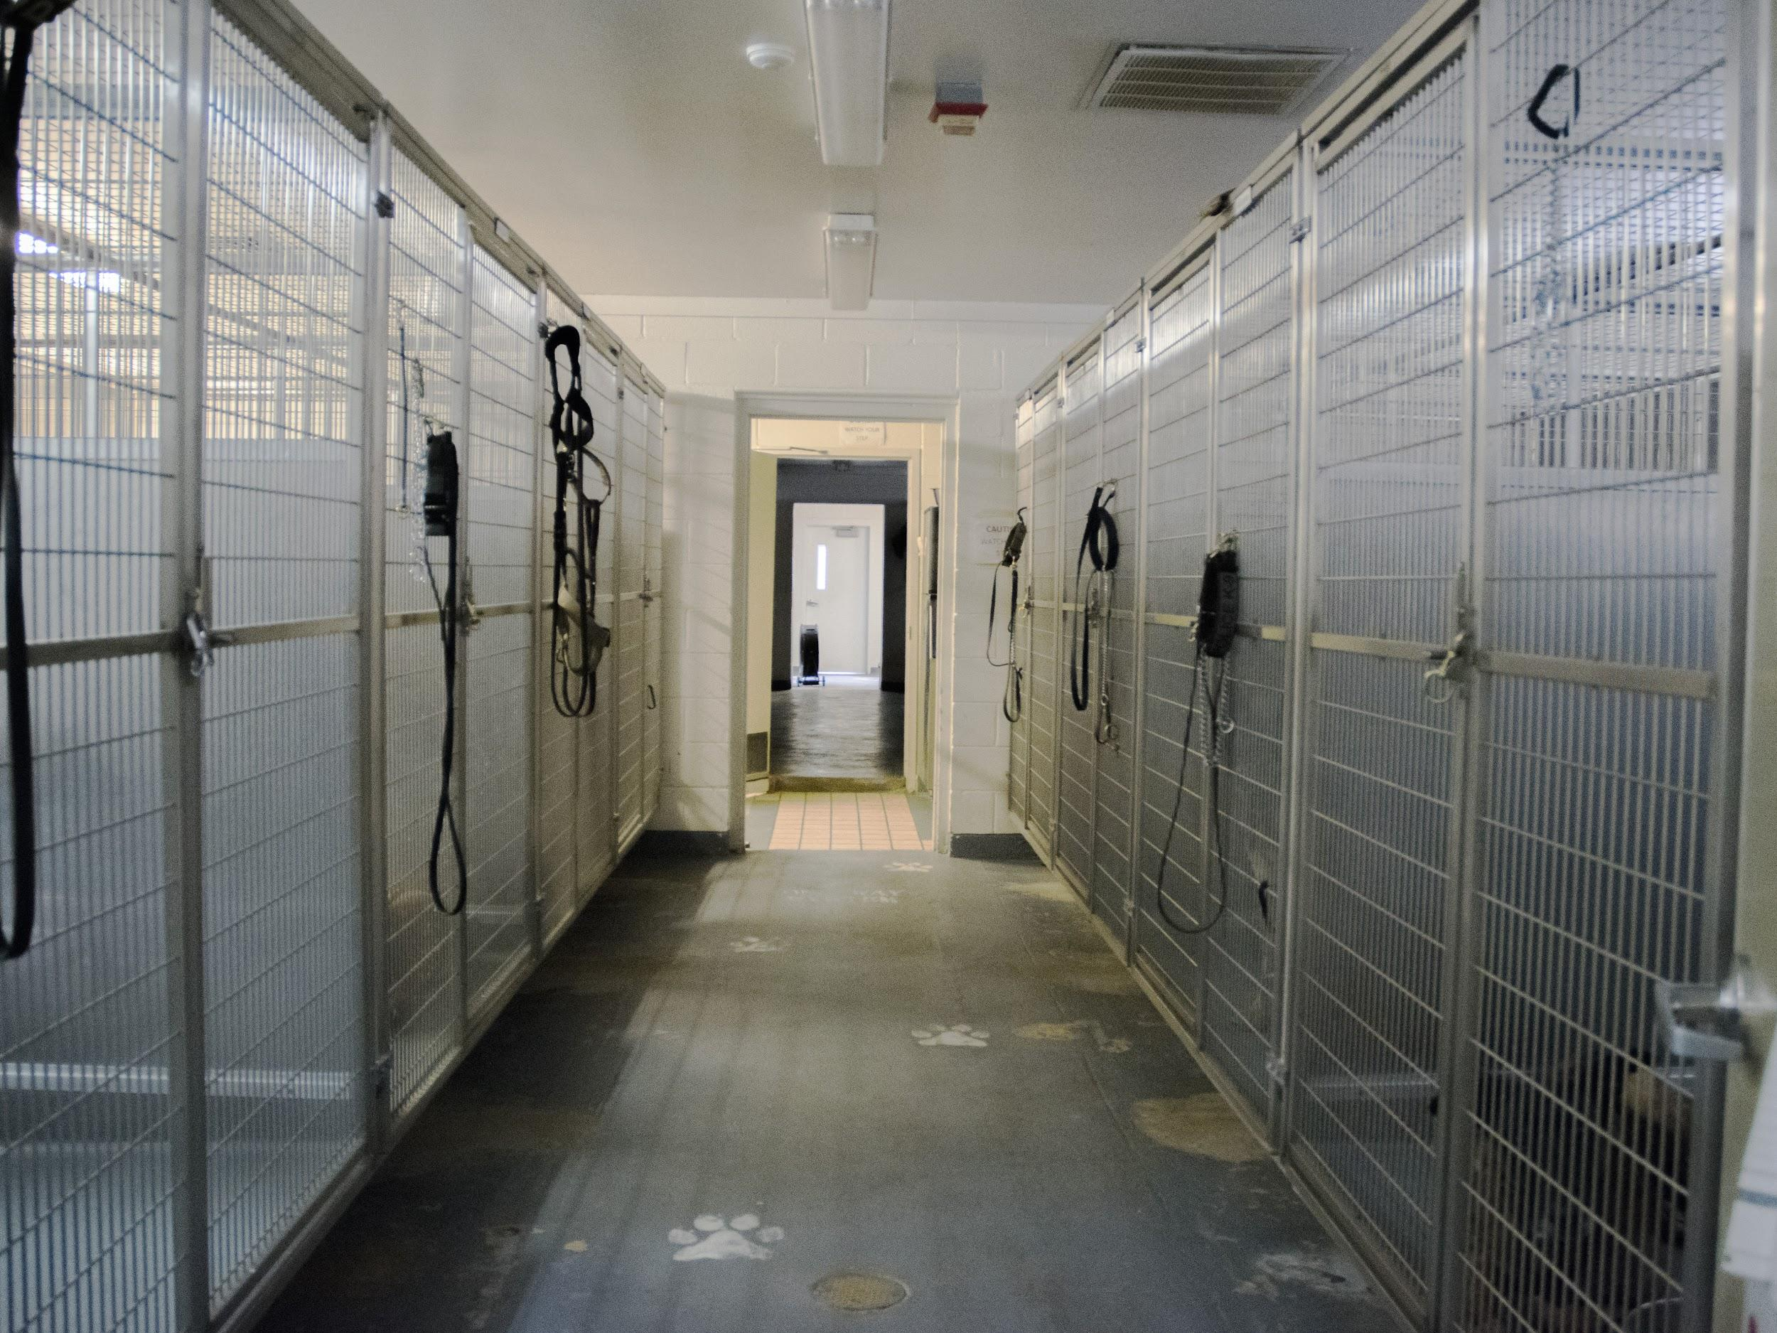
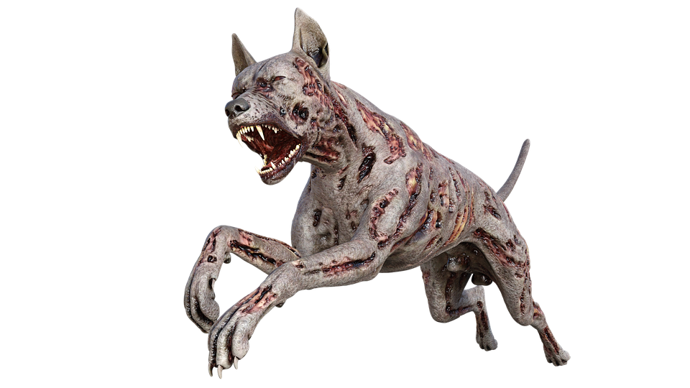

Move from Exam Room
The first door along the main hallway will lead into another exam room like the spawn area, and trigger the first cutscene. In the cutscene, a normal dog on the operating table will be given an injection and start to shake and bark in a Zombie Dog™ like fashion.
*meowww*
“AHHHH”
*WOOF WOOF*

Slide 8

Hidden Easter Egg Boss Dog Encounter
When the Lab is unlocked, a boss dog will be spawned that has much more health than a regular dog and unique attack patterns.
*WOOF WOOF*
*meowww*
“DIIIIIIIE”

Slide 9

Goal
The goal of Zombie Dog Outbreak 2 is to survive as long as possible. In order to “win” the game, specific actions must be done in the Lab and the Kitchen. Before this is possible, however, the cat must collect the hazmat suit by opening the closet room at the end of hallway. From there the player should make their way to the Kitchen, then place the ingredients into the blender to create the special serum.
*meowww*
*meowww*

Slide 10






Create the Cure
*meowww*
In order to create the cure, a Dog heart, Hair tuft, and Vial of reagent must be collected after they are dropped from dead dogs or discovered around the map.

Slide 11
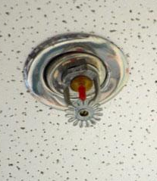
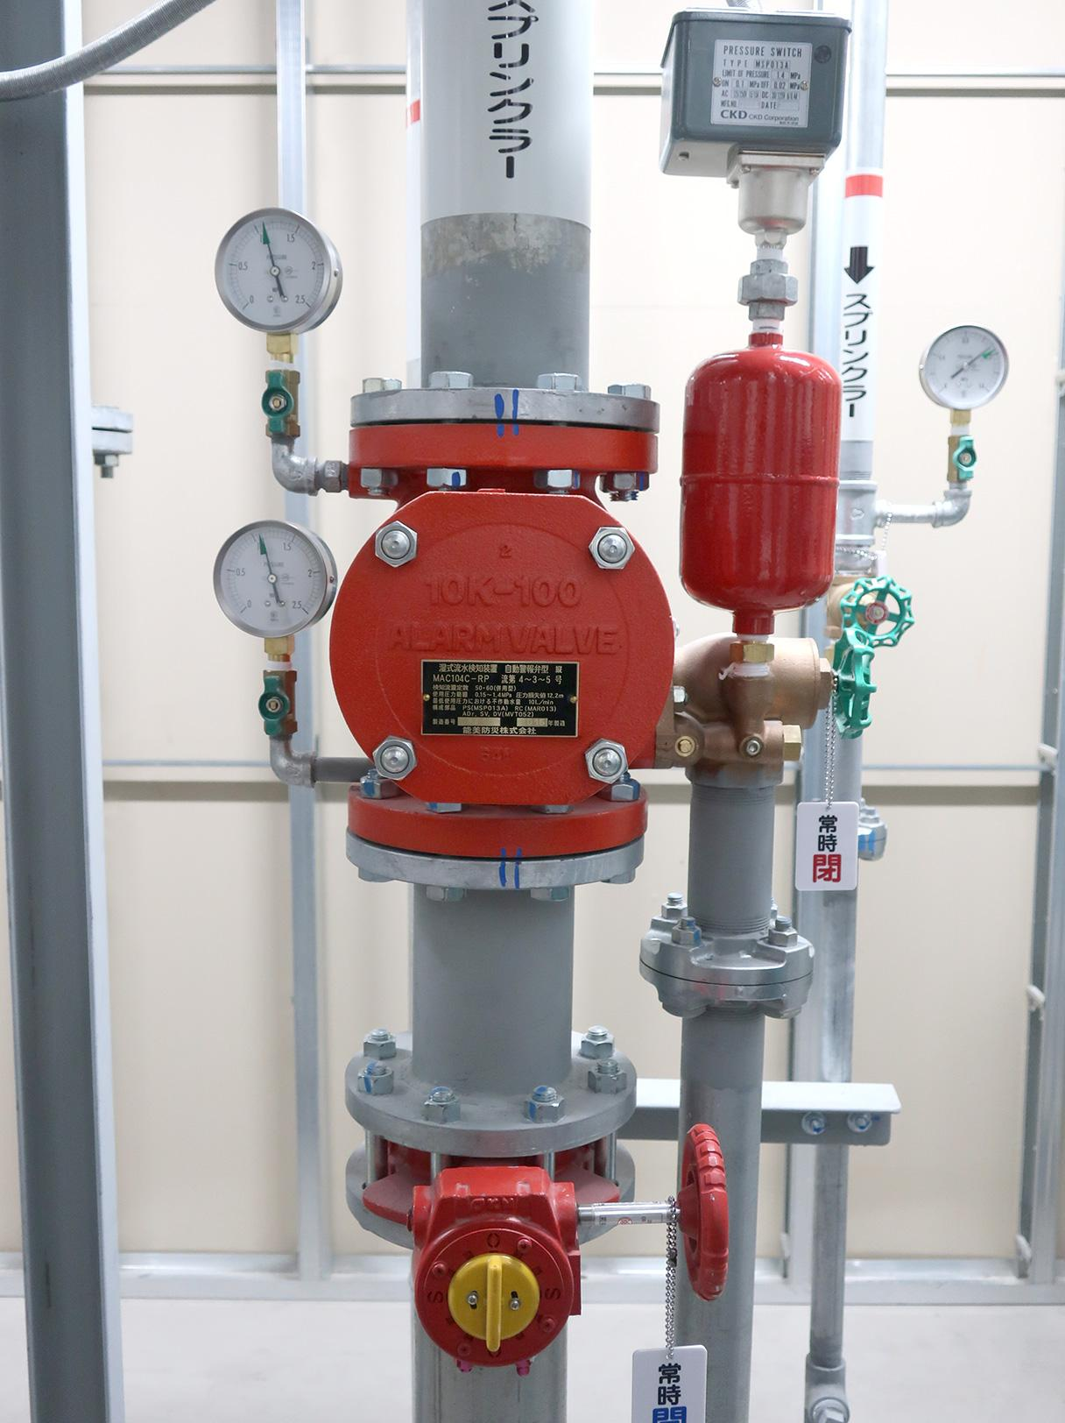


Spread the Cure
Once the player has created the special serum, the player must then fight their way through the hallway back to the Lab, where the serum must be placed into the sprinkler system to be diffused throughout the building.
*meowww*
“YESSSS i DID IT!!!”

Slide 12





Win the Game
Once the sprinklers are activated and begin to spray the special serum, a cutscene will play showing the zombie dogs turning back to normal dogs. Then the screen will go black and show the cat chilling on the beach, free of the Zombie Dog™ outbreak.
meow
*woof woof*

Slide 13

Global Use Case
Instantiate Game
Play Sounds
Shoot Zombie Dog
<<include>>
<<include>>
<<include>>
Pick up items
<<extend>>
<<include>>
Zombie Dog Dies
Player
Display Cutscenes
Access Inventory
Control
Character

Slide 14
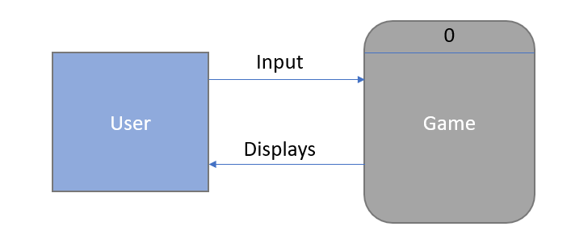
Context Diagram

Slide 15
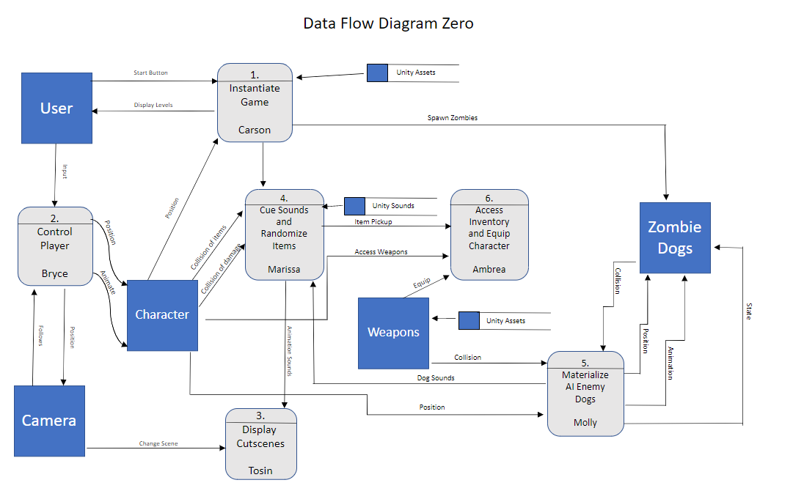
Diagram Zero

Slide 16
Carson SubSystem: GameManager & MapManager scripts
Priority:
1 - Without a script to create and manage all important game elements and start the gameplay, the game could not exist.
Complexity:
This script will likely be one of the most complex components, as it will need to interface with many distinct objects. The algorithms in the GameManager script will all be fairly simple, however, as the more specific scripts that are referenced will be performing the detailed actions needed for the game.

Slide 17
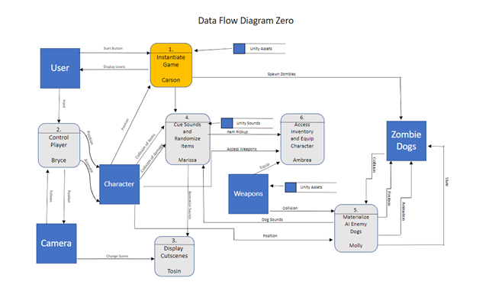
Carson SubSystem

Slide 18
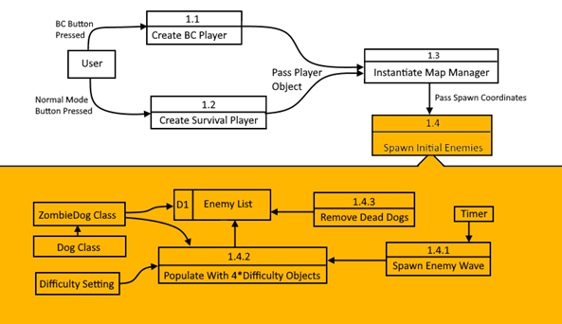
Carson SubSystem

Slide 19
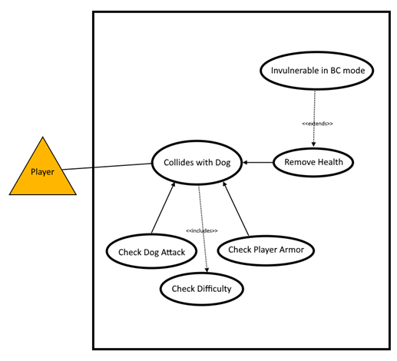
Carson SubSystem

Slide 20
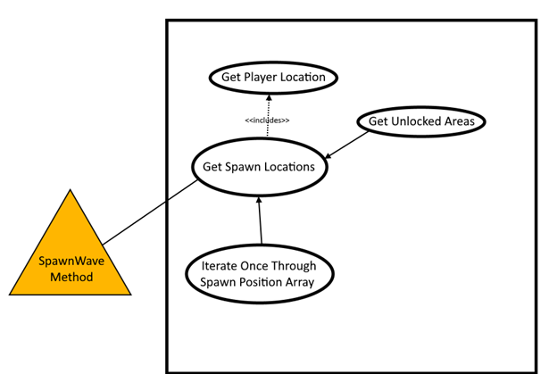
Carson SubSystem

Slide 21
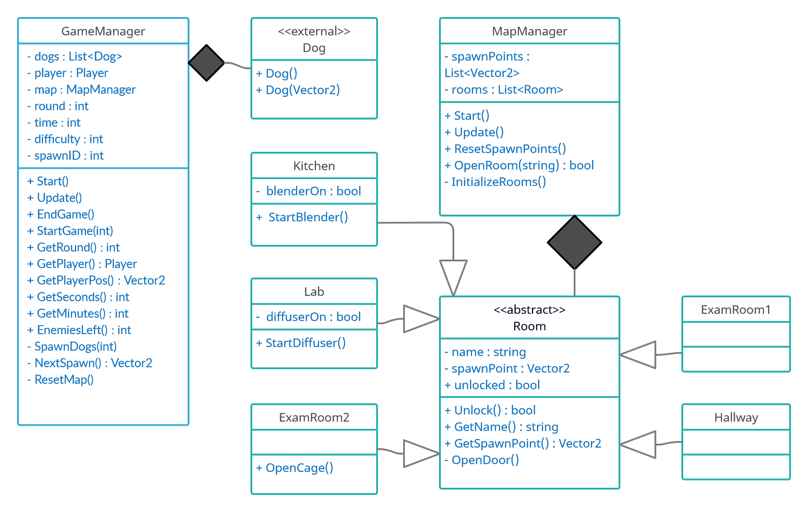

Slide 22
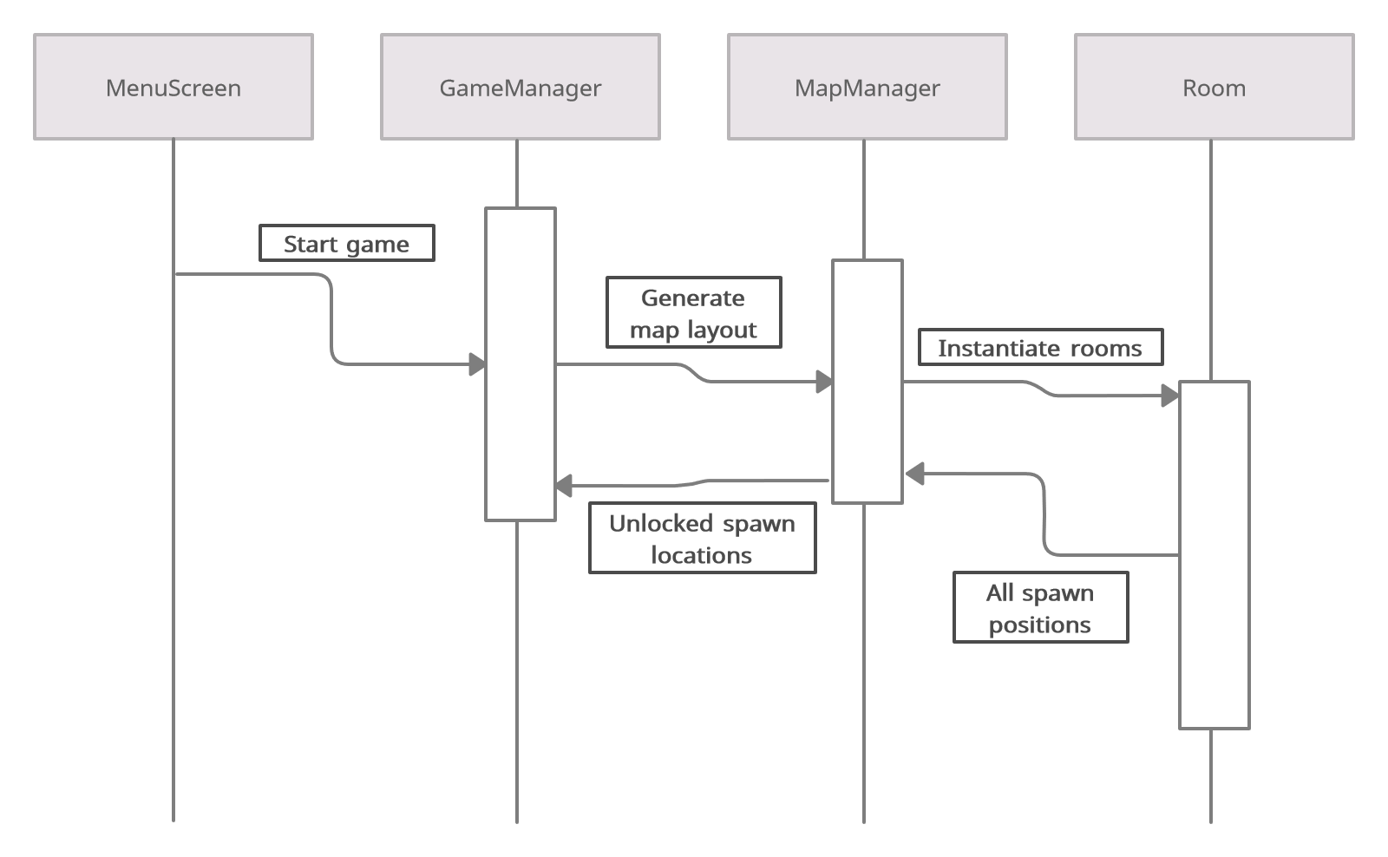

Slide 23
Bryce Subsystem: Player Feature
Priority: 1*
The player element of Zombie Dog Outbreak 2 is a must have in order for the user to interact with the game.
*The priorities are 1 = must have, 2 = essential, 3 = nice to have.

Slide 24
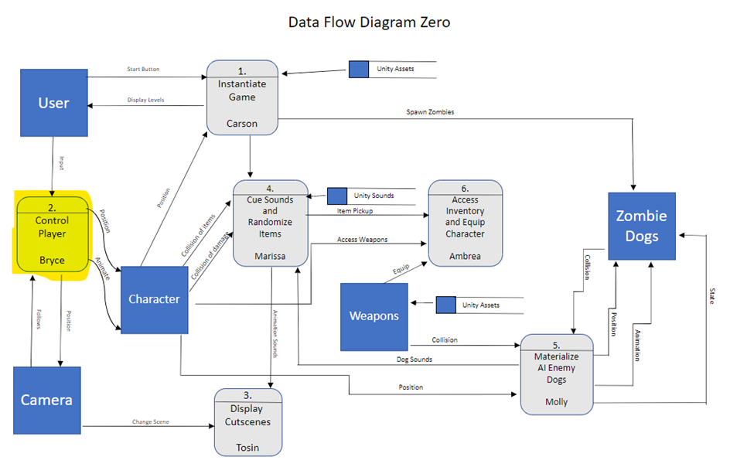
Bryce Subsystem

Slide 25
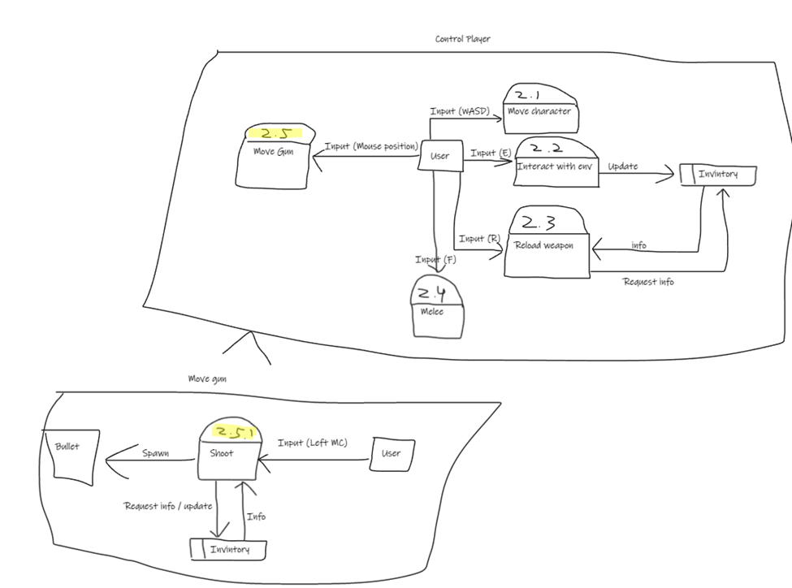
Bryce Subsystem

Slide 26
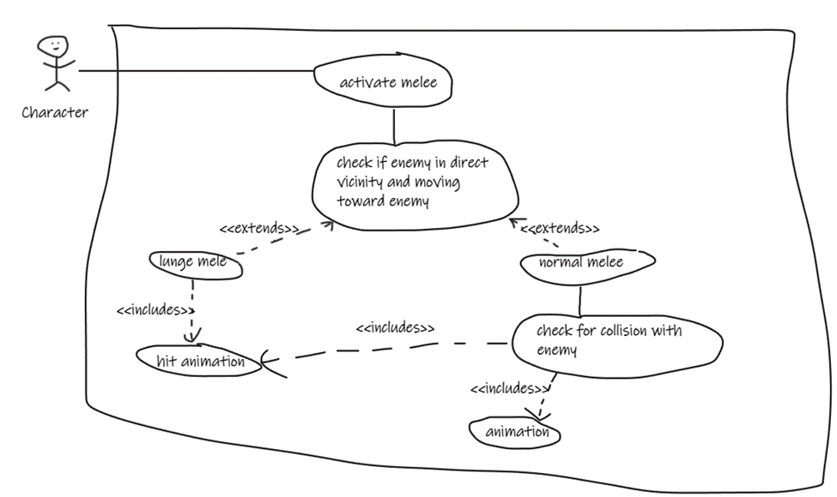
Bryce Subsystem

Slide 27
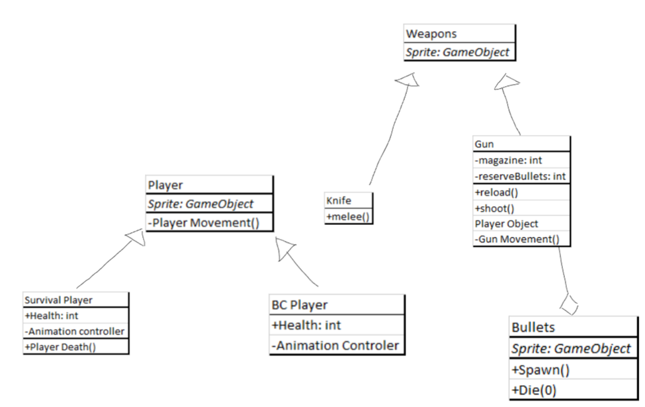
Bryce Subsystem

Slide 28
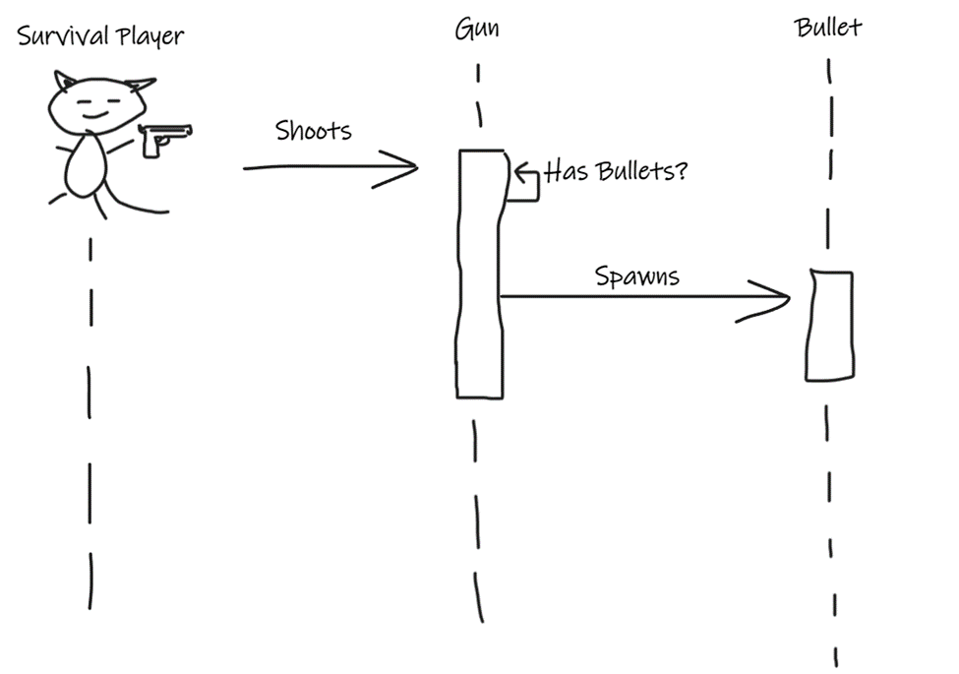
Bryce Subsystem

Slide 29
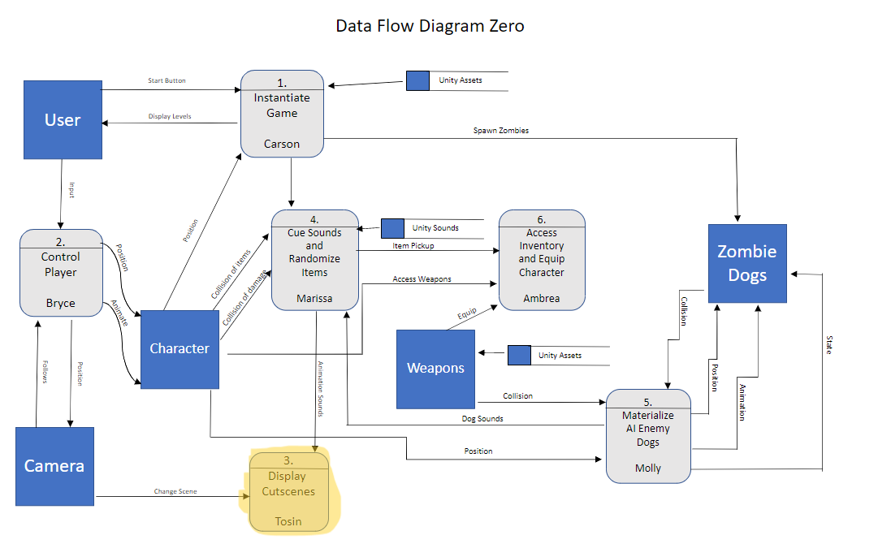
Tosin Subsystem

Slide 30
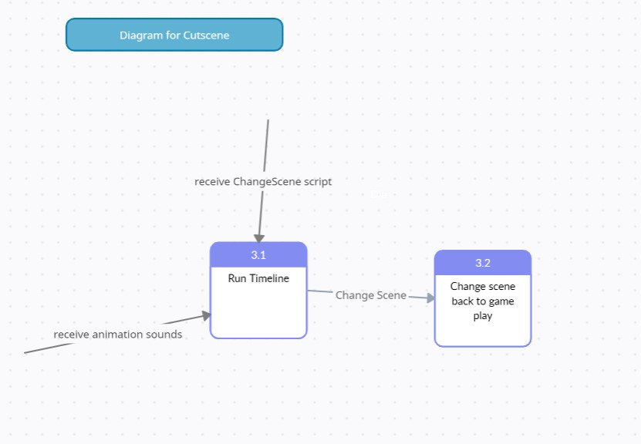

Slide 31
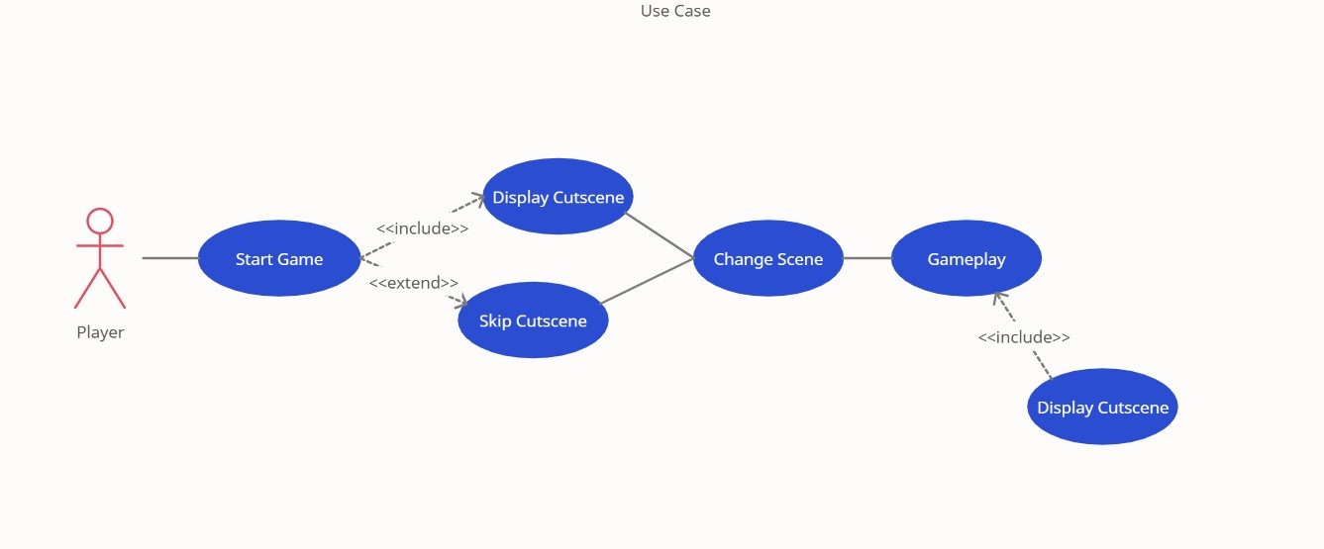

Slide 32
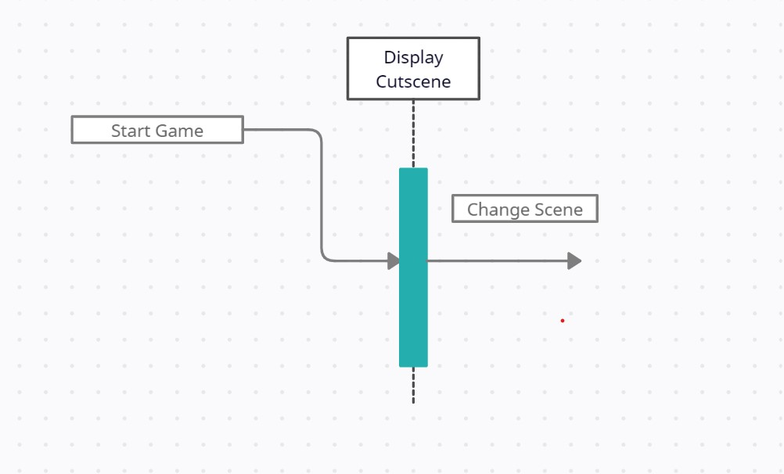

Slide 33
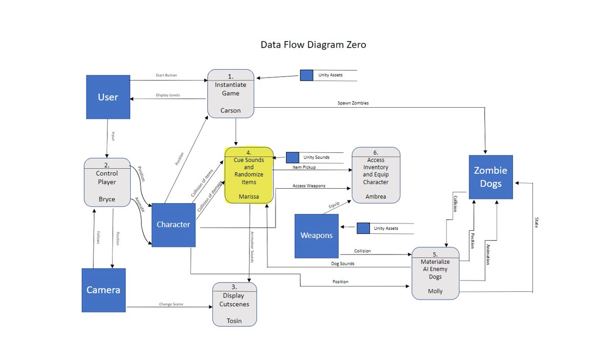
Marissa SubSystem

Slide 34
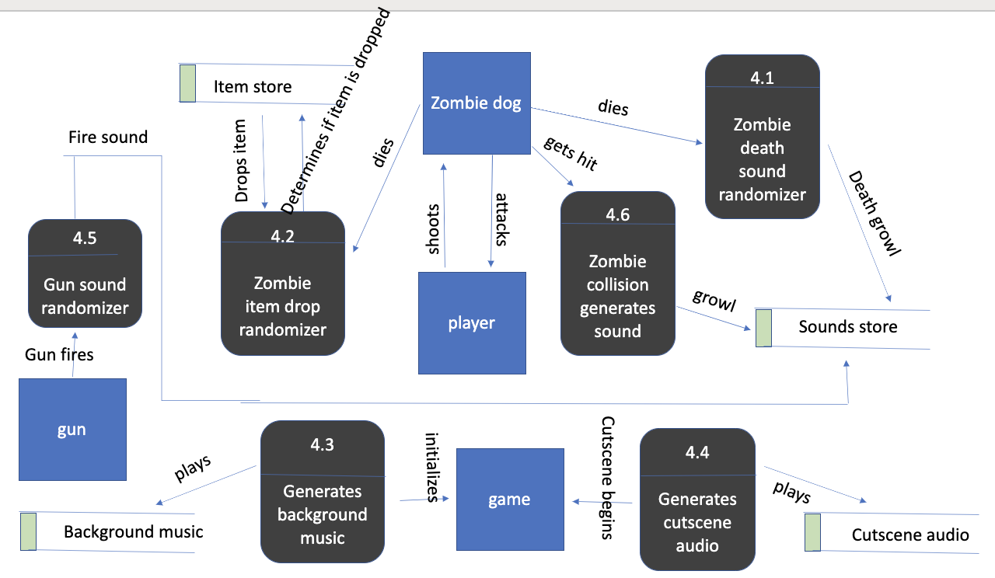

Slide 35
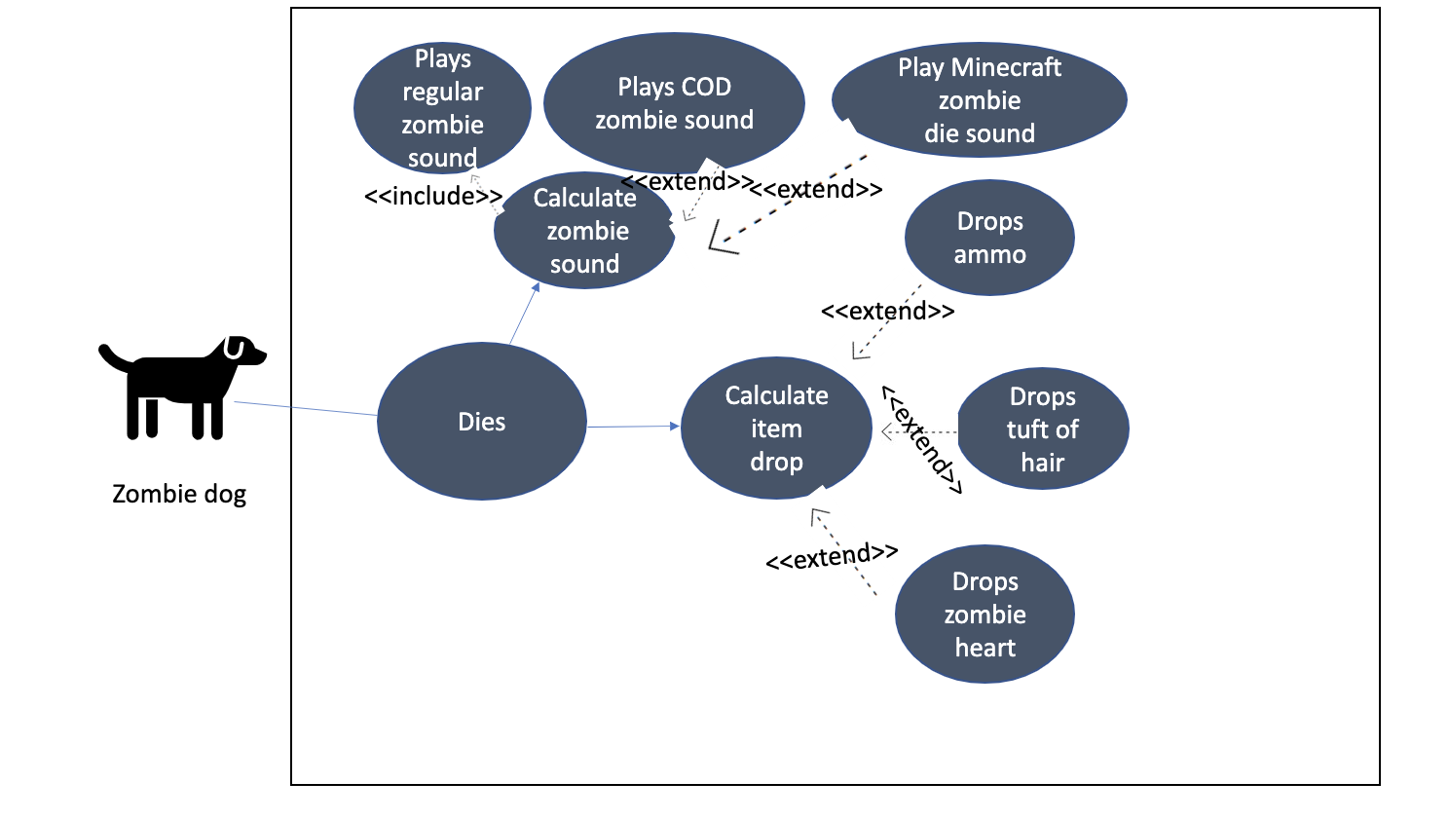

Slide 36
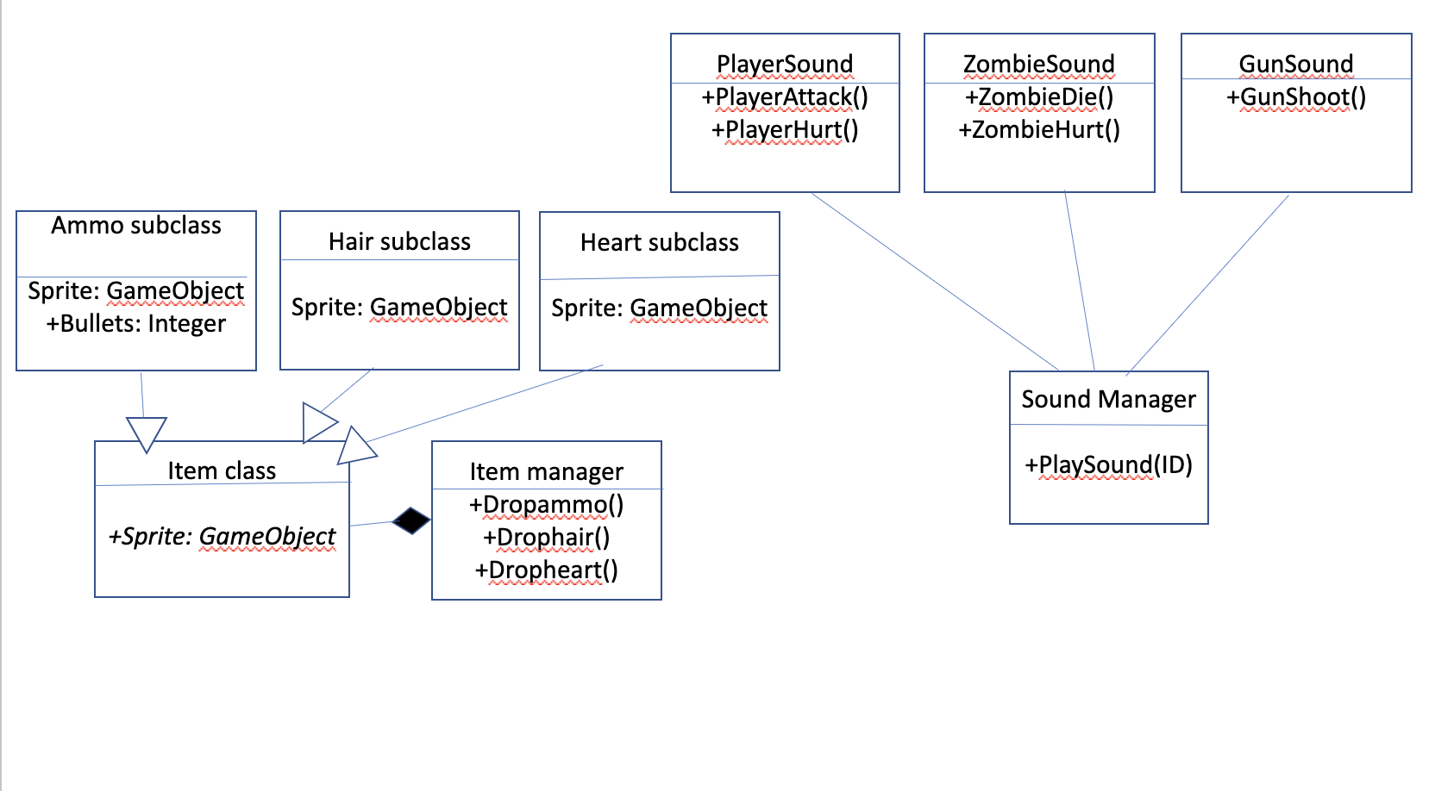

Slide 37
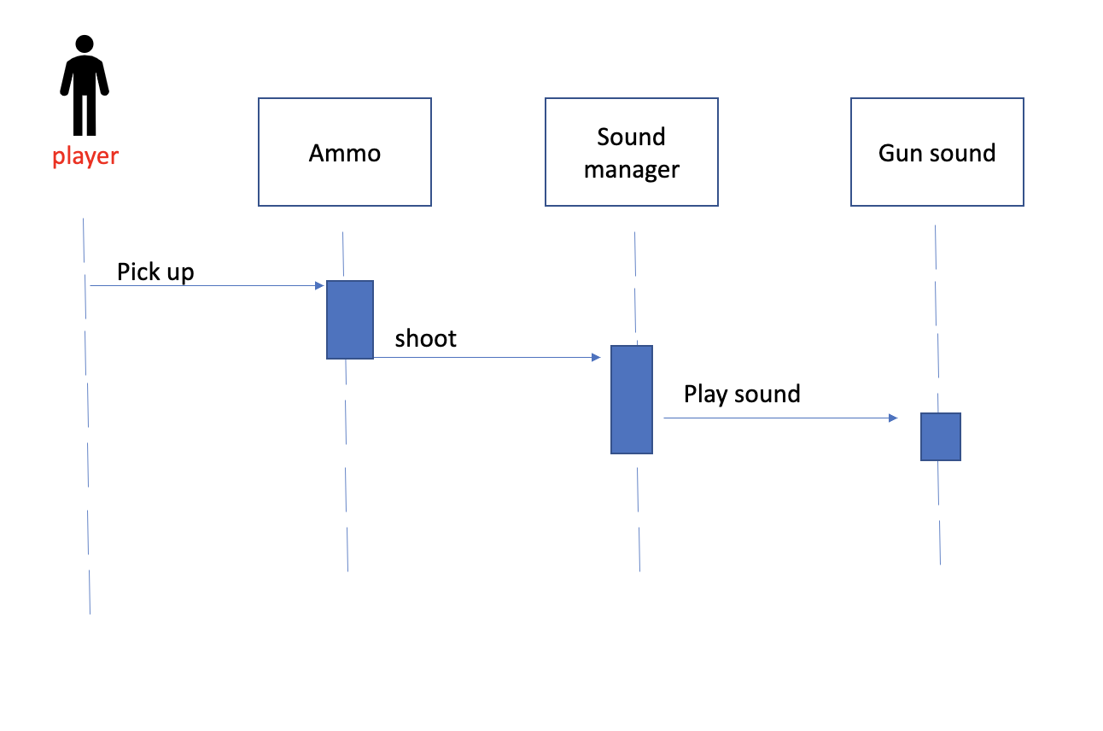

Slide 38
Sound and Item Manager Feature
Priority:
Sound Manager
3, sound is not necessary but the game would be boring without it
Item Manager
2, some of the items are necessary for the easter egg story, but the ammo drops are necessary to progress the game
*The priorities are 1 = must have, 2 = essential, 3 = nice to have.
Complexity:
Medium complexity, my feature is going to be called by other people’s code so it needs to work for theirs to succeed
Questions?

Slide 39
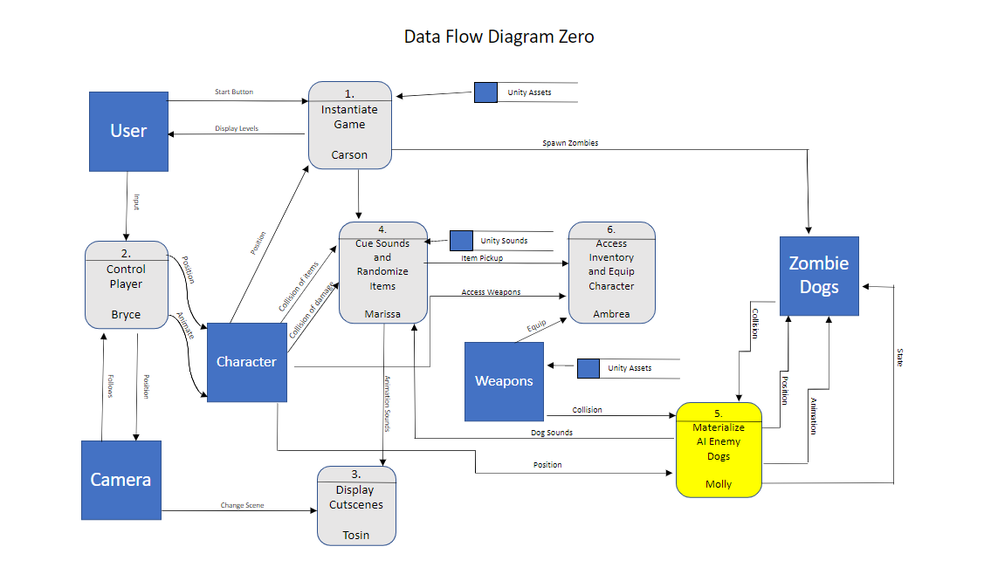
Molly Subsystem

Slide 40
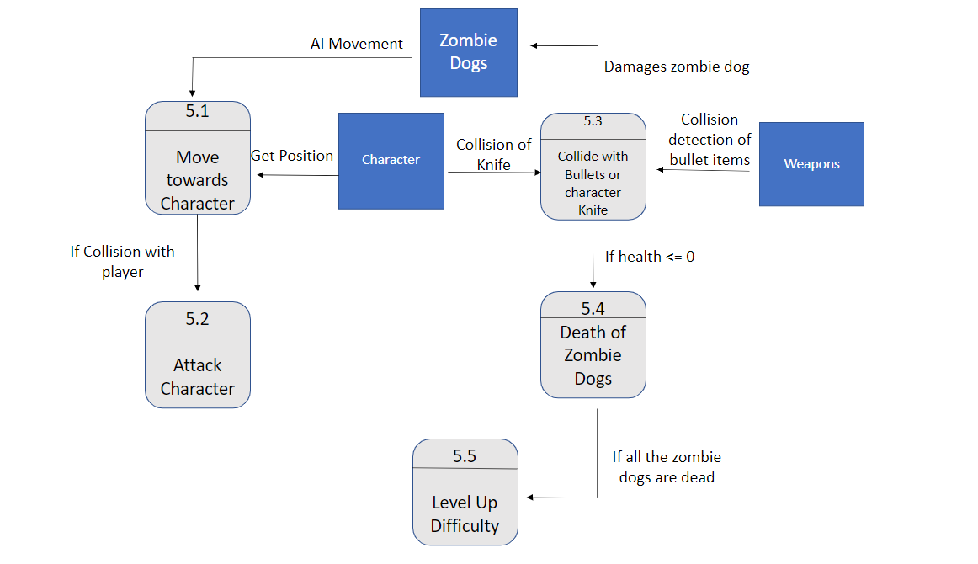

Slide 41
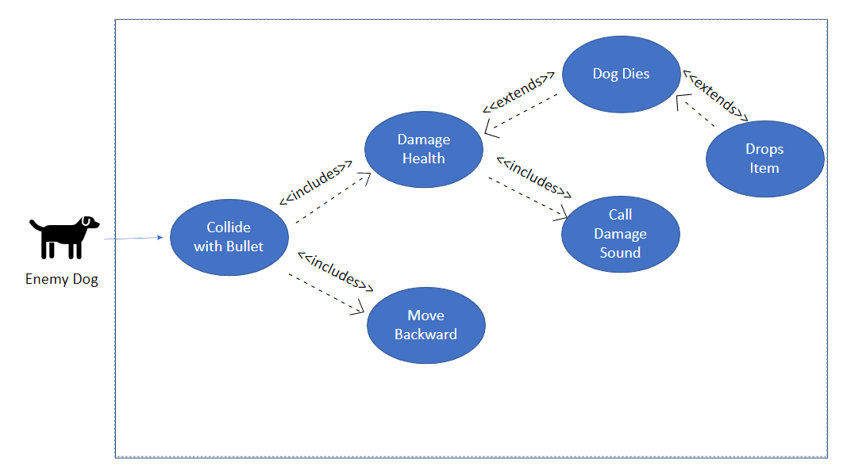

Slide 42
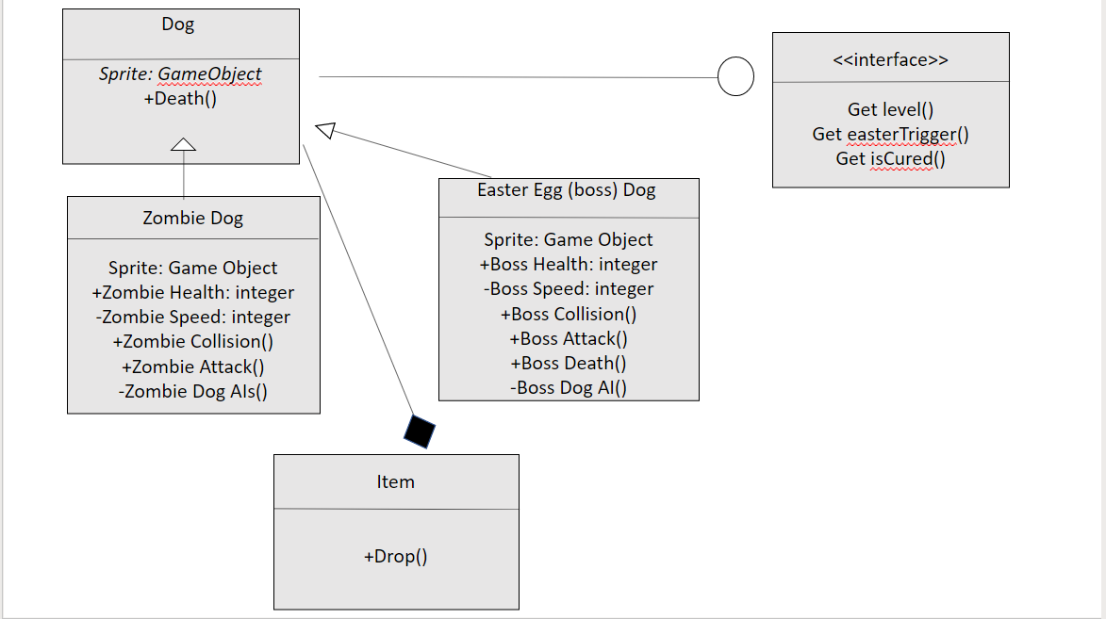

Slide 43
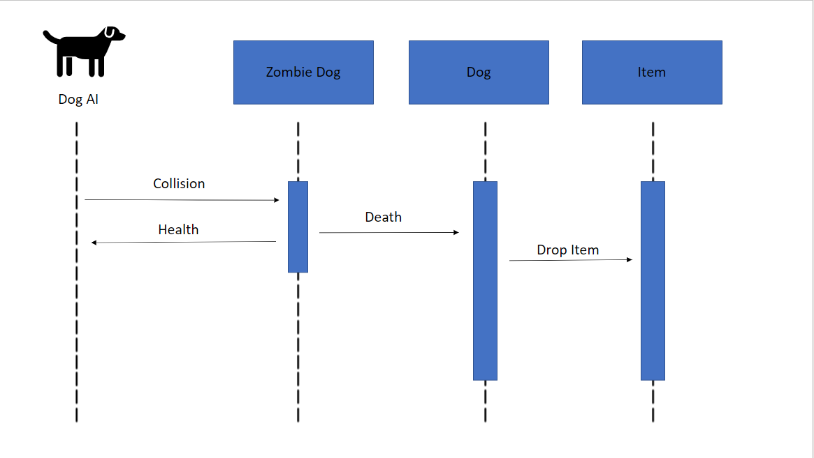

Slide 44
Enemy Feature
Priority:
2, you can have a game without an enemy but it wouldn’t be very fun and for the storyline of our game it is essential.
*The priorities are 1 = must have, 2 = essential, 3 = nice to have.
Complexity:
Most Likely the most complex of the game since it will have an AI controlling the dogs movement, attack, and death sequences.
Questions?

Slide 45
Ambrea Subsystem

Slide 46
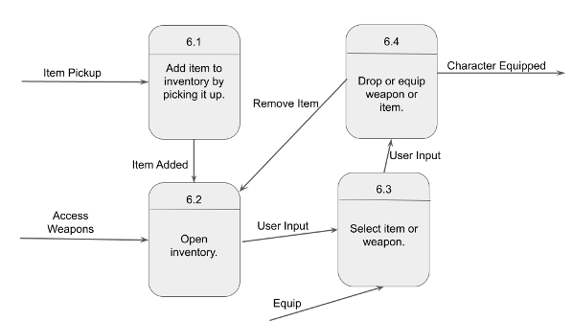
Add item to inventory

Slide 47
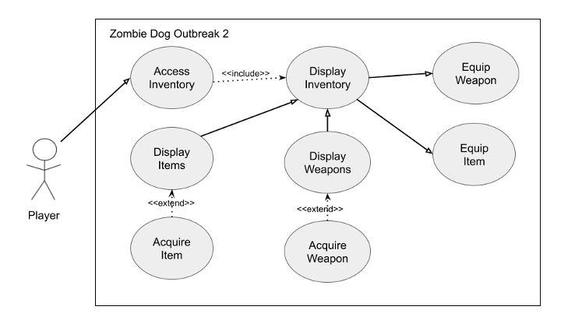

Slide 48
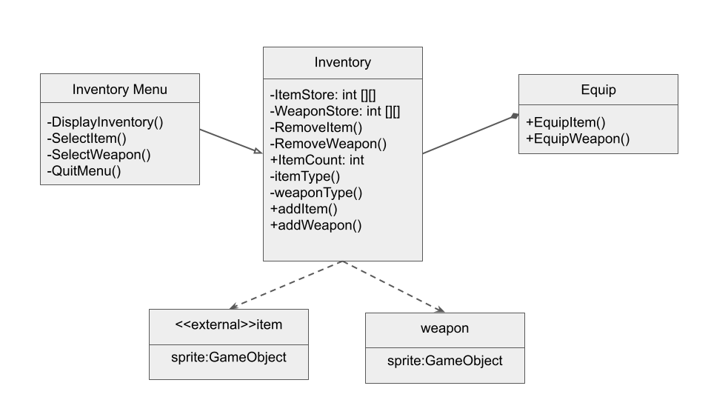

Slide 49
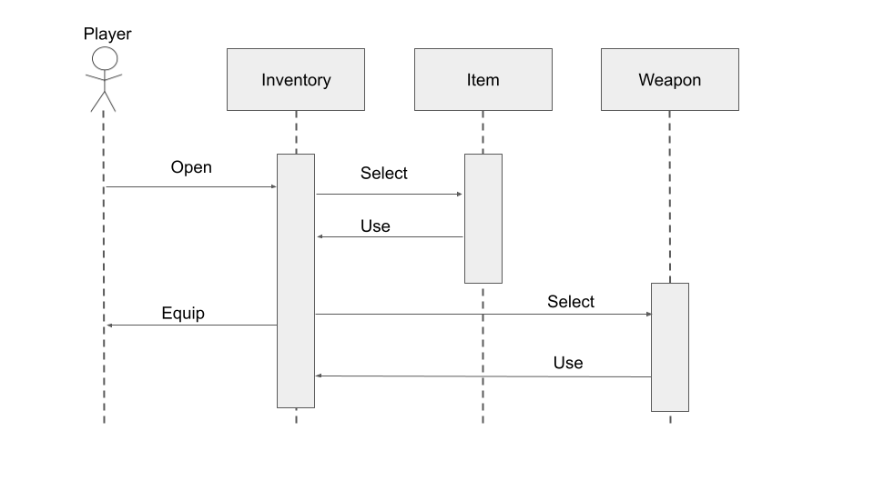

Slide 50
Inventory Feature and UI
Priority: 2
Inventory: will need to store some items to access other features and store
UI: Will need a start menu, inventory menu, and a pause menu.
*The priorities are 1 = must have, 2 = essential, 3 = nice to have.

Slide 51

Questions

